Slide 1
HORIZON 2020
SWAFS NCP Info Day
Brussels, 2 February 2016
RTD B7 - Science with and for Society
RTD-7.1 Gender Sector

Slide 2
Gender Equality in the ERA
Gender in Horizon 2020, three objectives
Further news

Slide 3
1- Gender equality in the ERA
Council Conclusions – 1st December 2015
Strengthen the implementation, monitoring and evaluation of gender equality in H2020
Continue structural / institutional change in research organisations – in particular through gender equality plans
New : set guiding targets
  Full professors
  Decision-making bodies
Gender equality in the dialogue with third countries

Slide 4
1-Gender equality in the ERA
Next steps
- National Action Plan / Strategy
  By May 2016
- ERA conference 26 May
- Era Progress Report 2016
  Autumn 2016
Involvement of the Helsinki Group, in collaboration with other ERA-related groups (SF International Cooperation, SG Human Resources & Mobility)

Slide 5
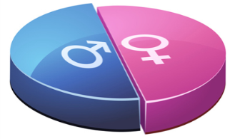
2 - Gender in H2020: 3 objectives
Gender balance in decision making processes
Gender balance in research teams at all levels
Gender dimension in research and innovation (R&I) content
Notes:
Advisory groups for the European Commission
- 50 % men / women
- at least one expert with gender expertise
Evaluation panels and expert groups for the EC
- 40 % under-represented sex taking into account the situation in the field of the action

Slide 6
H2020 WP:
balanced participation in research teams/ management structures
Reporting
Early reporting of workforce
Proposal
indicate the gender of the person primarly responsible for carrying out the project's activities
Grant Agreement
Equal opportunities and gender balance at all levels
Evaluation
If same scores, gender balance in teams is a ranking factor
Notes:
Model Grant Agreement
Article 33 Gender Equality
Obligation to aim to the extend possible, for a gender balance at all levels of personnel assigned to the action, including at supervisory and managerial level.

Slide 7
The gender dimension in the content of R&I
Gender balance in decision making processes
Gender balance in research teams at all levels
Gender dimension in research and innovation (R&I) content

Slide 8
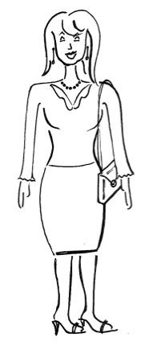
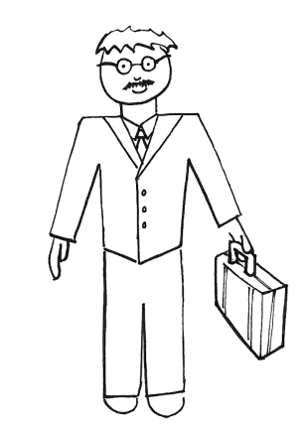
Sex and gender: definitions
Sex refers to biological characteristics of women and men, boys and girls, in terms of reproductive organs and functions based on chromosomal complement and physiology. As such, sex is globally understood as the classification of living beings as male and female, and intersexed.
Gender refers to the social construction of women and men, of femininity and masculinity, which varies in time and place, and between cultures.

Slide 9
Gender dimension in the content of R&I
Gender dimension in research content means integrating sex and gender analysis into research.
In other words, taking into account biological characteristics and social/cultural features of both women and men in R&I.
It is an added-value in terms of innovation, creativity, excellence and returns on investments
Notes:
- sex and gender differences are not carved in stone. If your research affects humans and/or animals, it is important to explore if there are any relevant sex and gender differences.

Slide 10

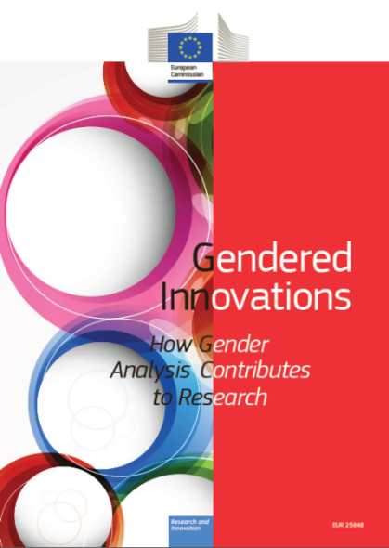
Concrete examples of gender dimension
"Gendered Innovations"
employs methods of sex and gender analysis to create new knowledge.
Website contains checklists for different research fields!!
http://ec.europa.eu/research/gendered-innovations/
Notes:
aybe you have heard of the "gendered innovations"? The publication and website provide great information on how to integrate the gender dimension in the content of research. You will find case studies and methodologies.
4 different checklists exists on: Engeneereing, Health and Medicine, Tissues and Cells, Urban Planning and Design

Slide 11
H2020 WP:
Some topics require a specific gender analysis
Reporting
Consortium shall report on the gender dimension if relevant as part of the deliverables.
Application form
"Where relevant describe how sex and/or gender analysis is taken into account in the project 's content"
Grant Agreement
Gender dimension is part of the DOW
Evaluation
Experts assess the inclusion of the gender dimension under the excellence criterion.

Slide 12
To remember
Include partner(s) with gender expertise
Use check lists from Gendered Innovations project
Answer question 1.3 of the application form on gender / sex analysis
Training on gender equality is an eligible cost
Leaving out gender dimension is a lost opportunity on innovation and weakens excellence
Gender balance in research teams is a ranking factor

Slide 13
3 - Further News
about gender equality
in Horizon 2020

Slide 14
WP 2016-2017

Slide 15
3 - Further news
Four indicators for gender equality as a cross-cutting issue:
  % women participants in Horizon 2020 projects
  % women project coordinators in Horizon 2020 projects
    MSCA fellows, ERC principal investigators
    Scientific coordinators in other Horizon 2020 activities
  % women in EC advisory groups, expert groups, evaluation panels
  % projects taking into account the gender dimension in R&I content

Slide 16
3 - Further news
On-line tool to help research organisations to set-up and implement gender equality plans
  Prepared in cooperation with the European Institute for Gender Equality
  Based on EU funded projects and similar national initiatives
  Launch in the autumn 2016
Final conference of the ERA-Net GenderNet
  Combined with the Conference of the Network on Gender Equality in Higher Education
  12-14 September in Paris

Slide 17
3- Resources on gender issues /expertise
GenPORT
On-line community of practionners
for sharing knowledge and inspire collaboration
www.genderportal.eu
Gender Toolkit
http://www.yellowwindow.be/genderinresearch/
Cost Action GenderSTE
http://www.genderste.eu

Slide 18
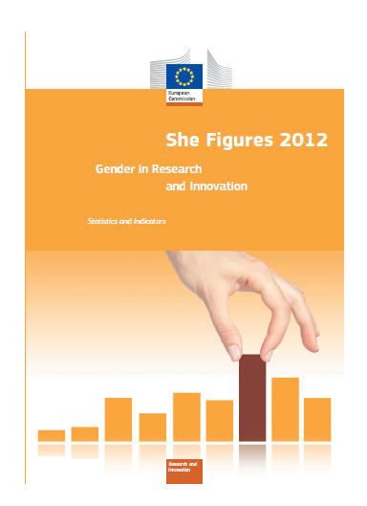


If you want to order our publications:

Slide 19
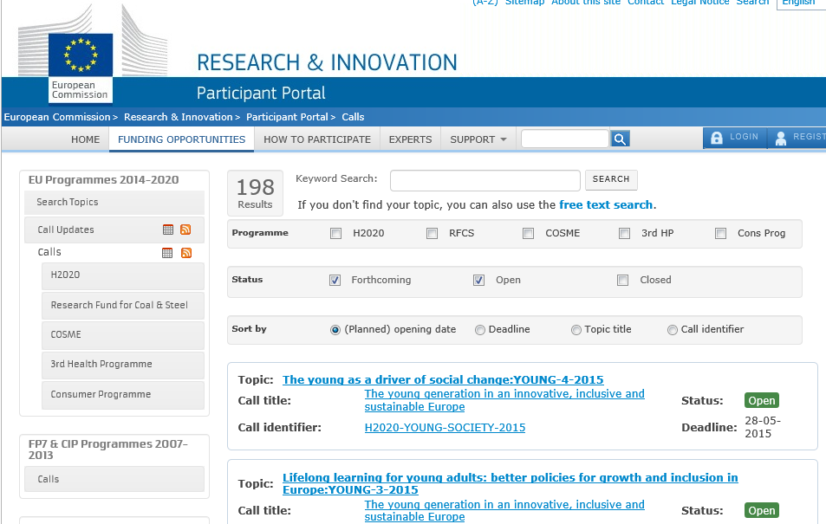
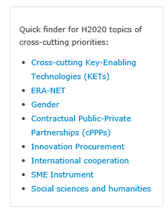

Slide 20
Thank you very much for your attention!
For any question contact:
RTD-GENDERINRESEARCH@EC.EUROPA.EU

